Slide 1
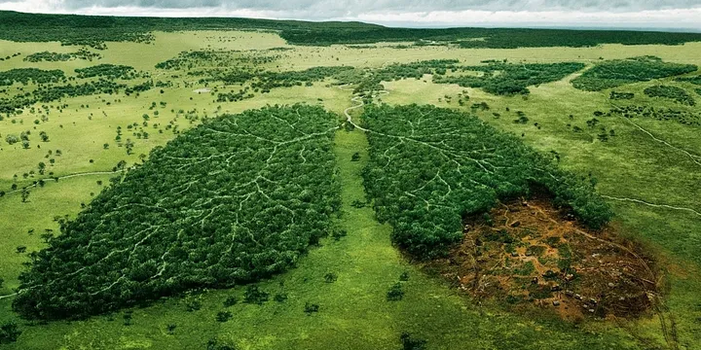

Global Air Quality
Southern Methodist University
Data Science Bootcamp
Project 3

Slide 2

Team 2 Members
Misha Borunda
Damarje Brown
Kimberly Childers
Jason Cisneros
Raheem Yusuff

Slide 3

Background
According to the World Health Organization, Air pollution is one of the greatest environmental risk to health that affects people from all different backgrounds
Outdoor air pollution in both cities and rural areas was estimated to cause 4.2 million premature deaths worldwide per year in 2019; this mortality is due to exposure to fine particulate matter, which causes cardiovascular and respiratory disease, and cancers
Addressing air pollution, which is the second highest risk factor for noncommunicable diseases, is key to protecting public health
Most sources of outdoor air pollution are well beyond the control of individuals and this demands concerted action by local, national and regional level policy-makers working in sectors like energy, transport, waste management, urban planning and agriculture.

Slide 4
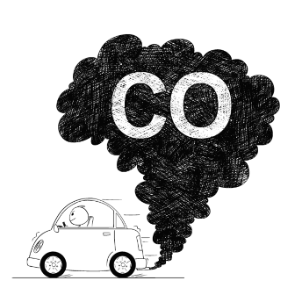
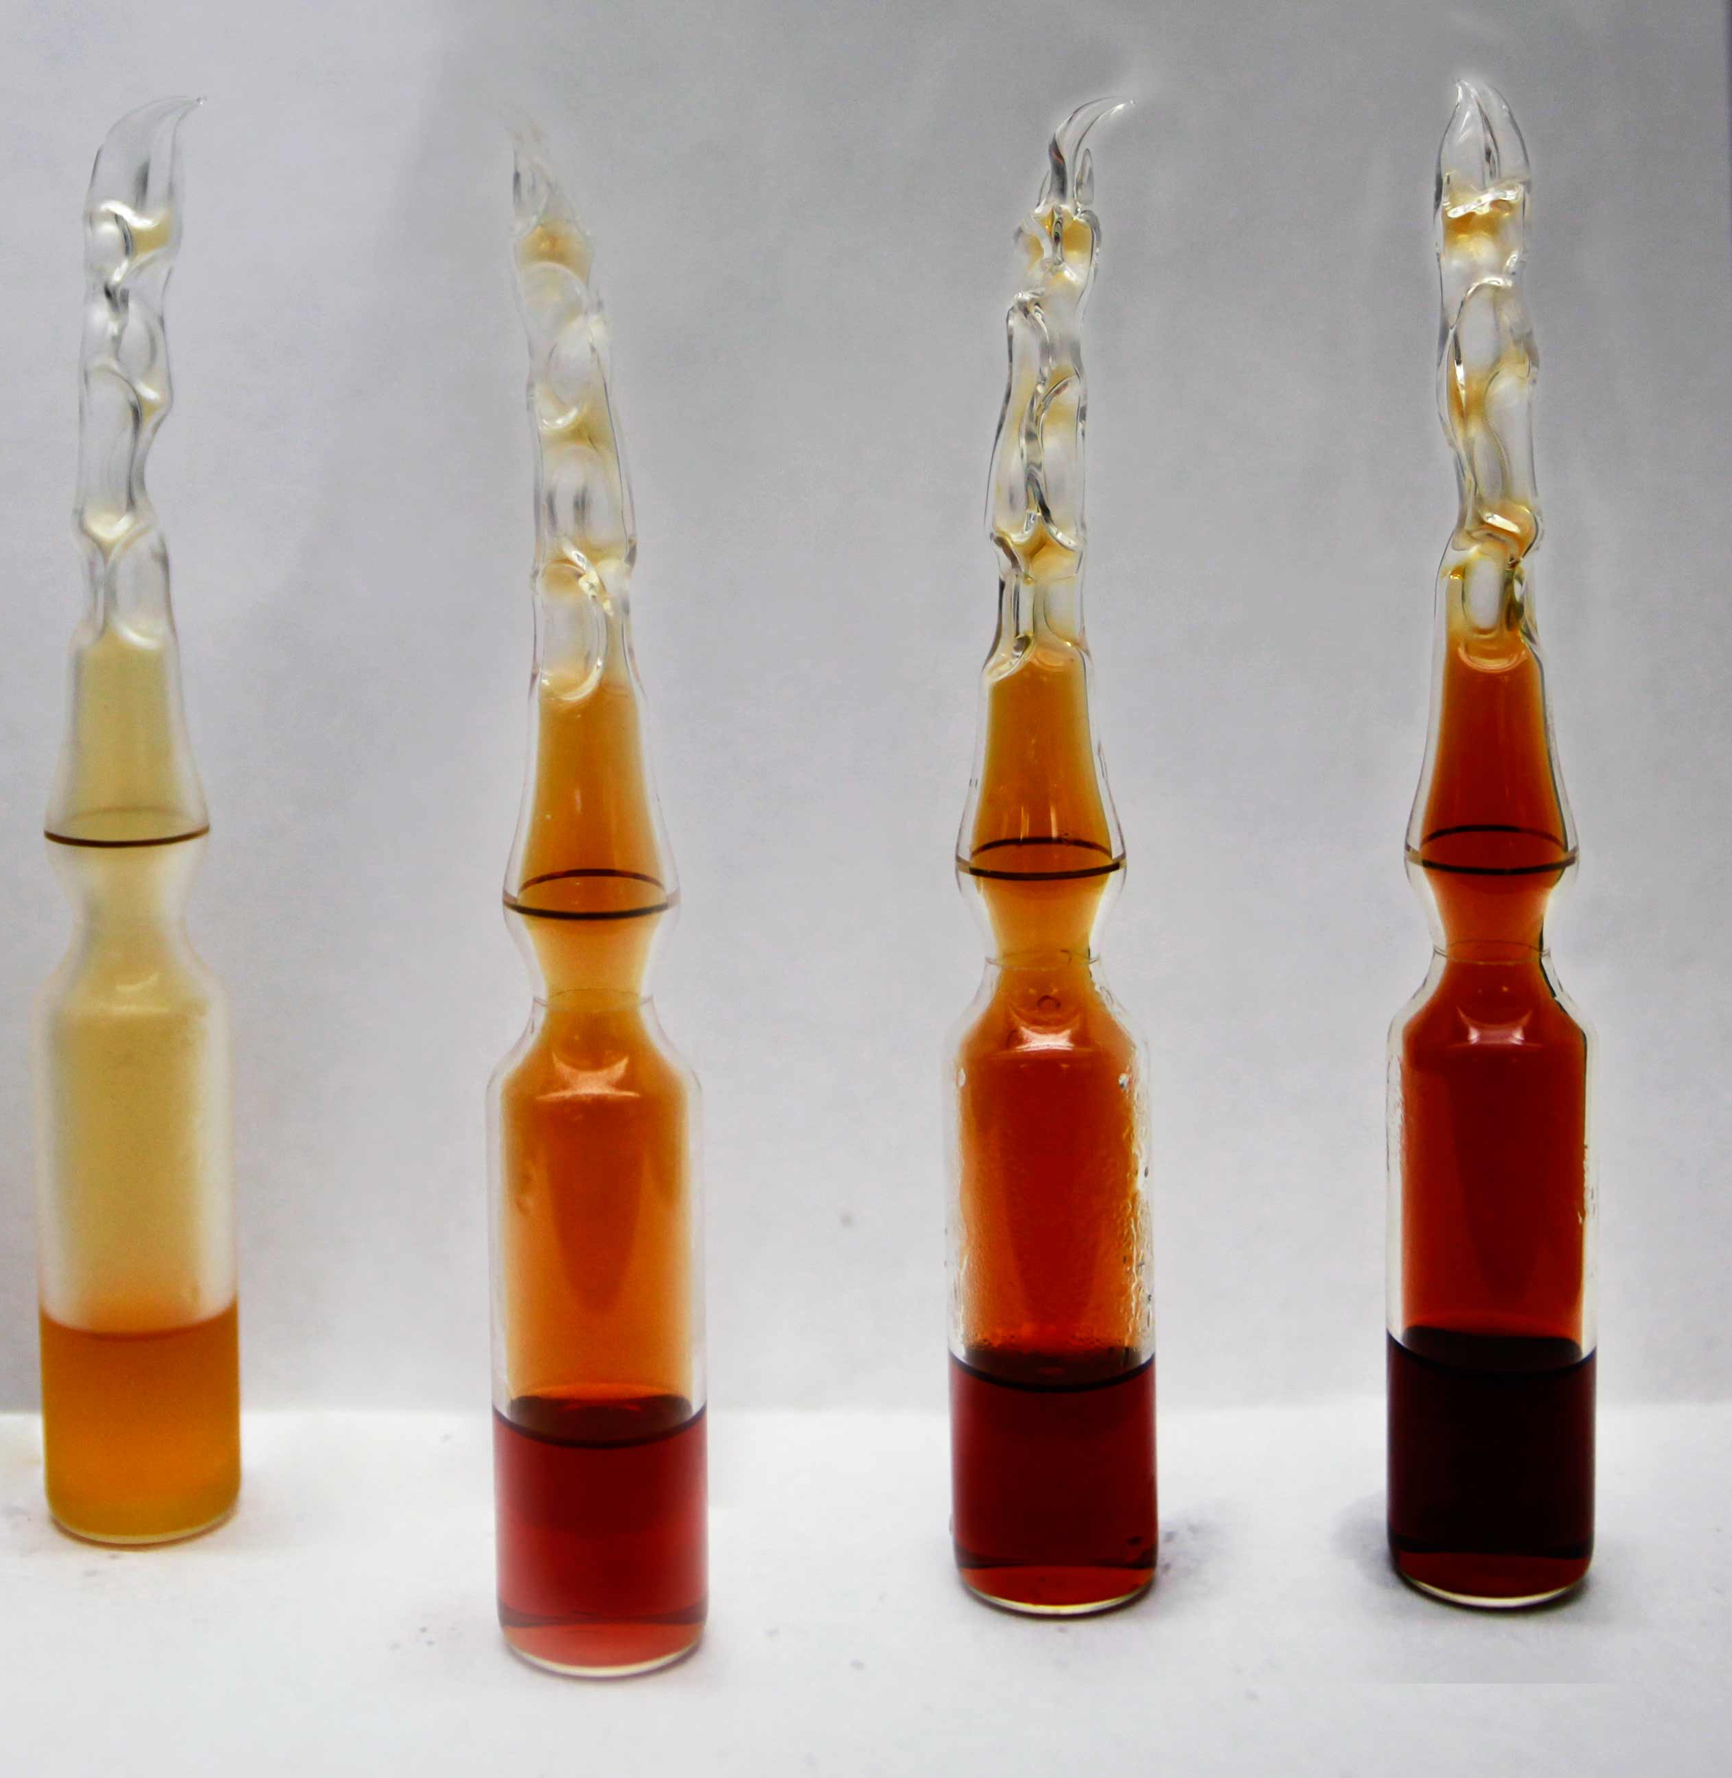
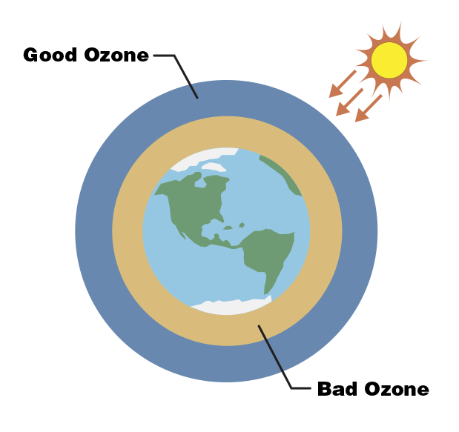
Technical Terminology
AQI Air Quality Index is used for reporting daily air quality. It tells you how clean or polluted your air is
Pollutants
Particulate matter (PM2.5) Fine Particulates such as sulfates, nitrates, ammonia, sodium chloride, black carbon, mineral dust and water.
Carbon monoxide (CO) Toxic gas produced by the incomplete combustion of carbonaceous fuels
Ozone (O₃) Ozone at ground level – not to be confused with the ozone layer in the upper atmosphere – is one of the major constituents of photochemical smog and it is formed through the reaction with gases in the presence of sunlight.
Nitrogen dioxide (NO₂) NO₂ is a gas that is commonly released from the combustion of fuels in the transportation and industrial sectors.

Slide 5
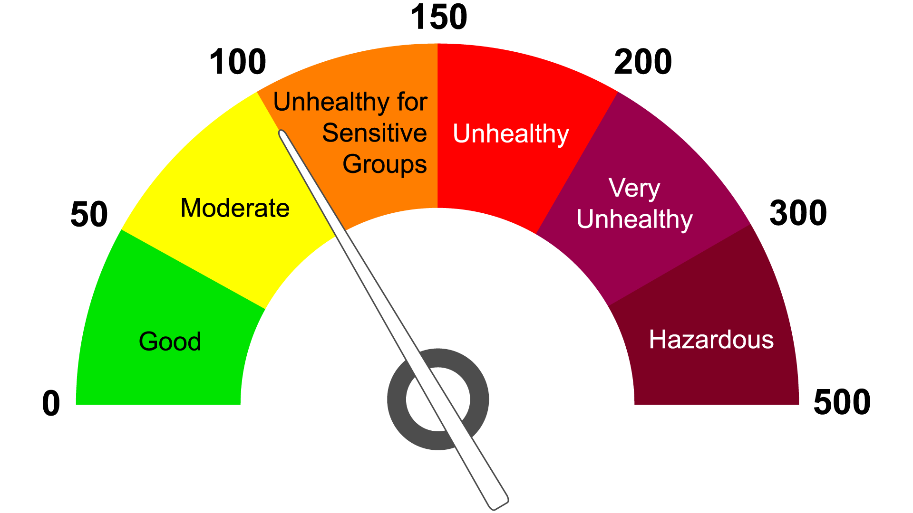
Air Quality Index

Slide 6
Data Set

Slide 7
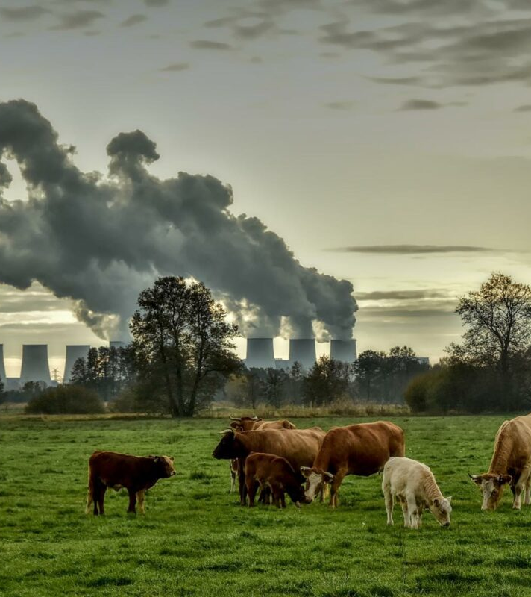
Research Questions
What are the top 10 countries with the best and worst Air Quality Index (AQI)?
What are the top 10 cities with the best and worst AQI?
Average AQI value per country?

Slide 8

Data Prep and Clean Up
The data set had zero null values which minimized the data cleaning that had to be done

Slide 9
Research Question #1

Slide 10
Research Question #2

Slide 11
Research Question #3

Slide 12
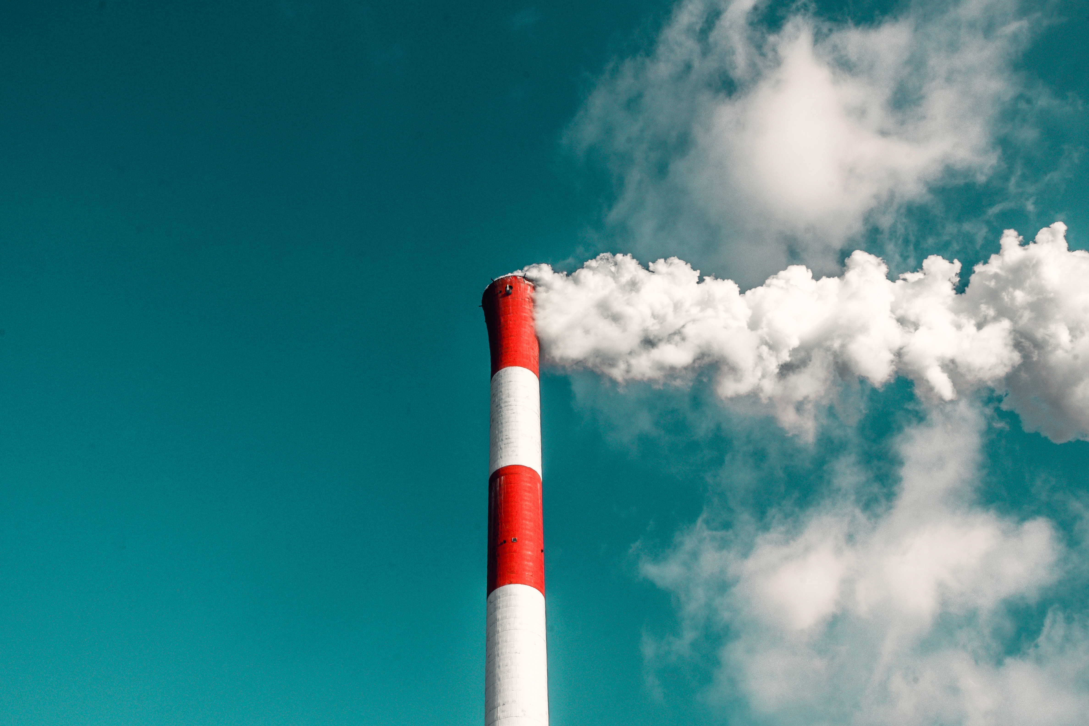
Conclusions

Slide 13

Limitations/Bias
Not all air quality pollutants are included in this data set such as Sulfur dioxide (SO₂)
There is no date/time information therefore it is unsure if the readings are all coming from the same point in time or throughout different dates
Some Cities have multiple entries while others have single ones. A more accurate analysis could be made if all locations got the same count of readings done on the same date.

Slide 14

Future Work
Can AQI readings fluctuate during the same day?
Does temperature have an effect of AQI values?
What age range is more sensitive to bad Air Quality?
Which Country has been the most successful in improving their overall air quality?
What industries are being more proactive in implementing solutions?

Slide 15

Image Links
https://www.news-medical.net/news/20230822/Can-air-pollution-shape-adolescent-brain-development-New-study-reveals-sex-specific-effects-of-PM25-NO2-and-O3-on-white-matter-microstructure.aspx
https://medium.com/mobile-development-group/lookout-air-quality-index-app-a59885eec085
https://www.lgnewsroom.com/2023/10/analyzing-and-managing-air-pollutants-to-create-better-life-for-all/
https://www.latimes.com/california/newsletter/2023-04-20/air-pollution-2023-essential-california-essential-california
https://genv.org/causes-of-air-pollution/
https://www.thelandofem.com/blog/2022/3/30/tox-in-the-land-carbon-monoxide
https://www.uia-initiative.eu/en/air-quality

Slide 16
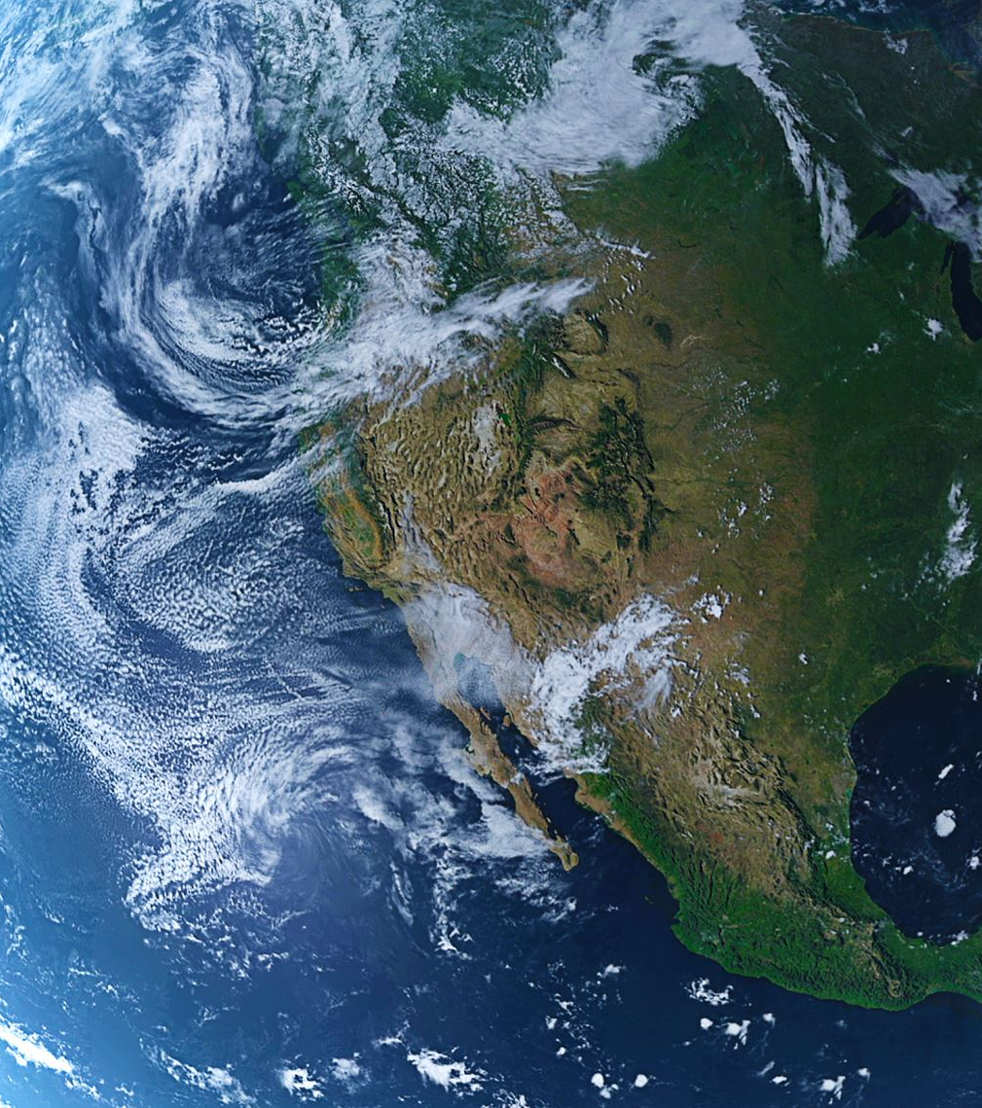
Article Links
https://www.weforum.org/agenda/2020/09/we-can-put-a-price-on-clean-air/
https://digitalprojects.davidson.edu/earthday2020/air-pollution/
https://www.deq.ok.gov/air-quality-division/ambient-monitoring/aqi-alerts-advisories/
https://www.who.int/news-room/fact-sheets/detail/ambient-(outdoor)-air-quality-and-health

